Slide 1
Functional Design Patterns in F#
https://bradcollins.com
https://twitter.com/bradleyscollins

Slide 2
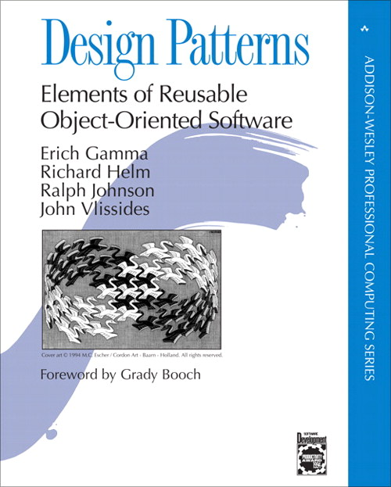
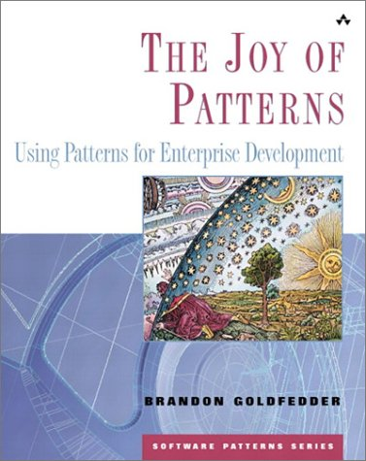
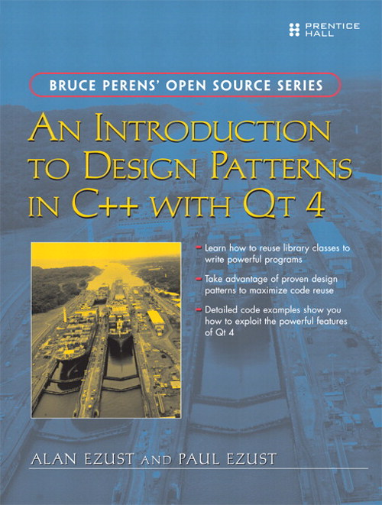
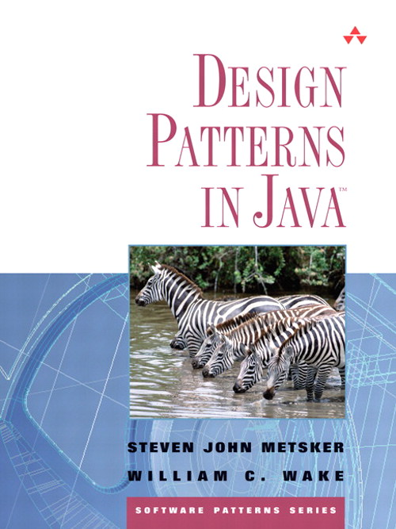
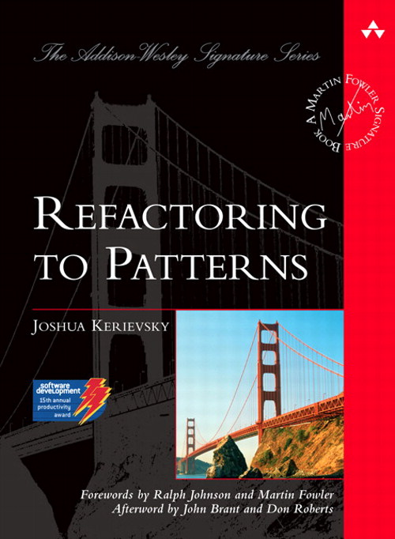
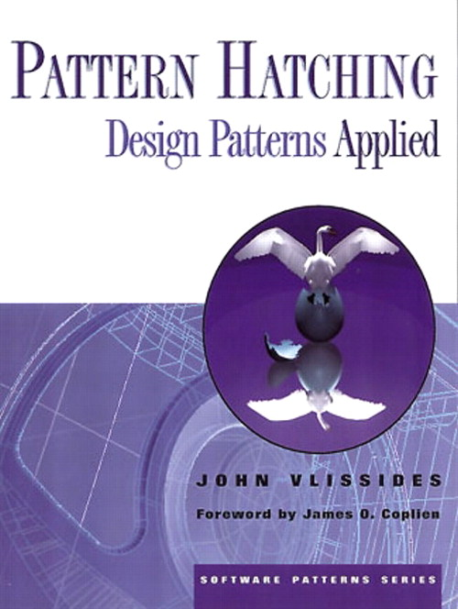
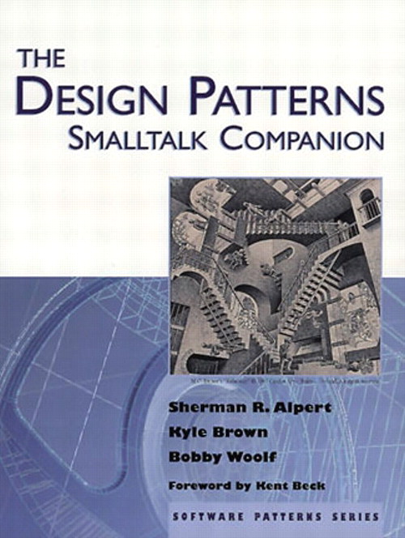
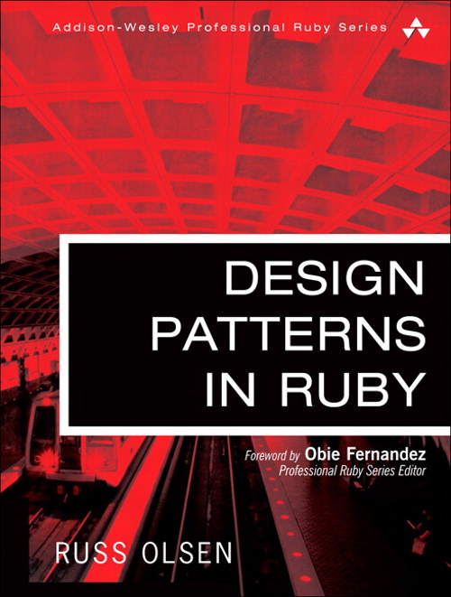
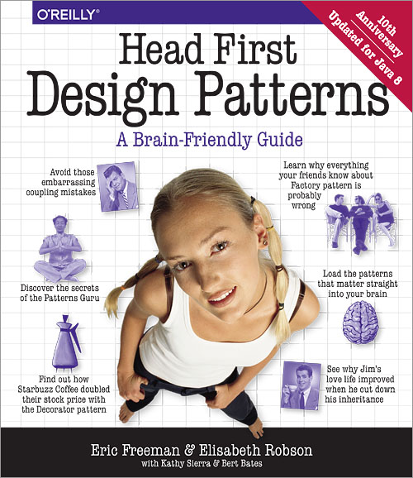
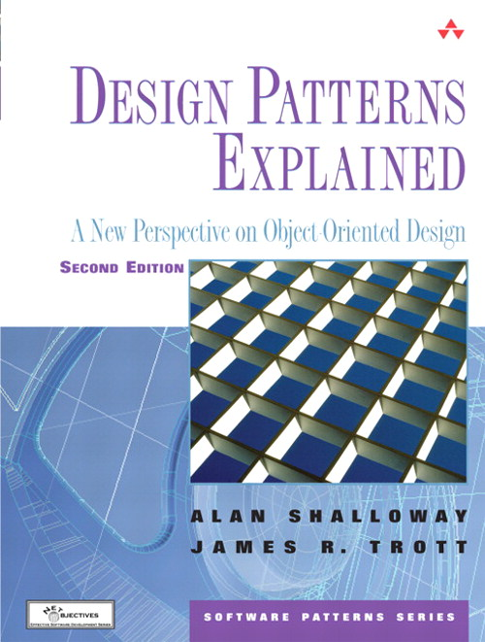
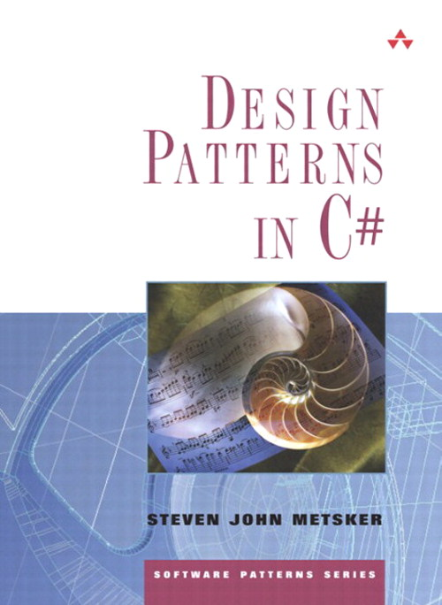
Notes:
If you are an object-oriented programmer, you read the Gang of Four book years ago.
And/or maybe one of the myriad books of its like
And now you are a pattern wizard!

Slide 3
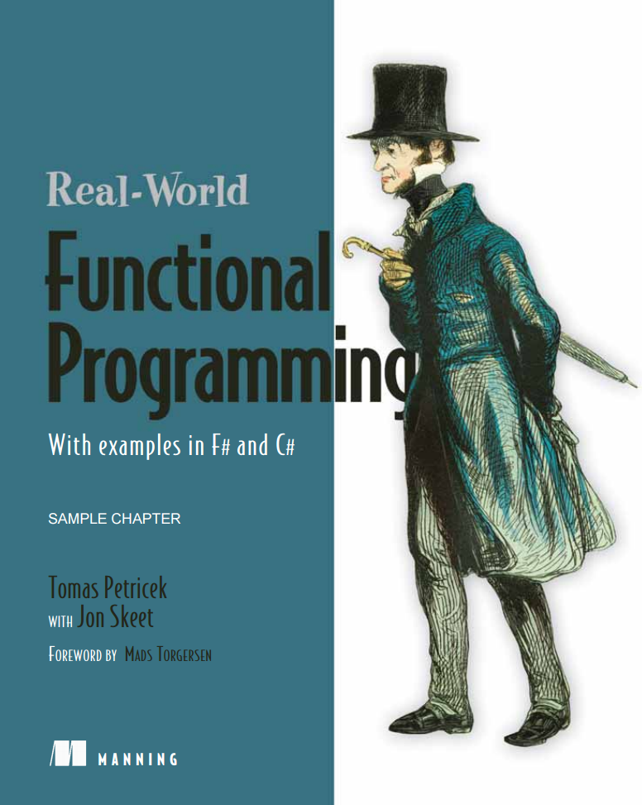
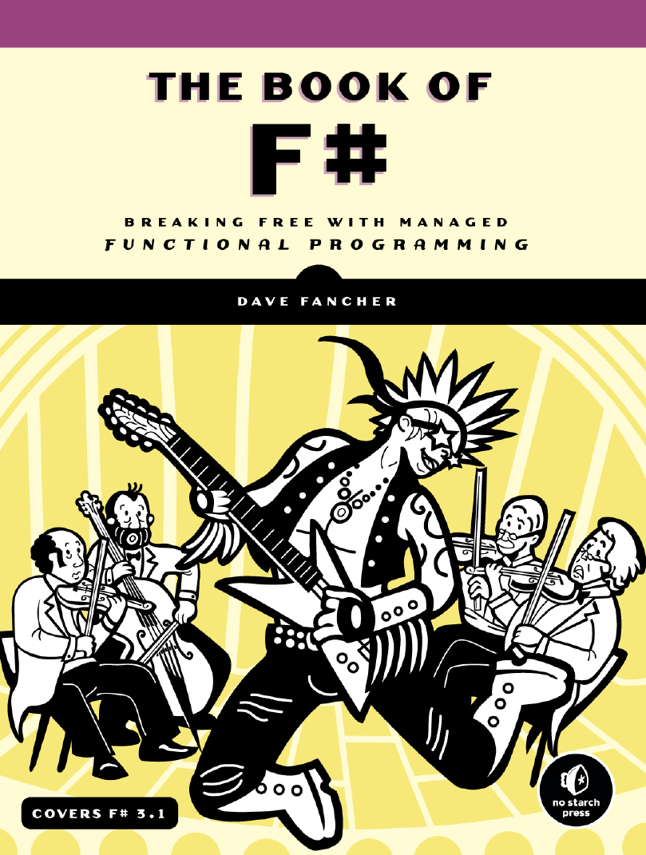

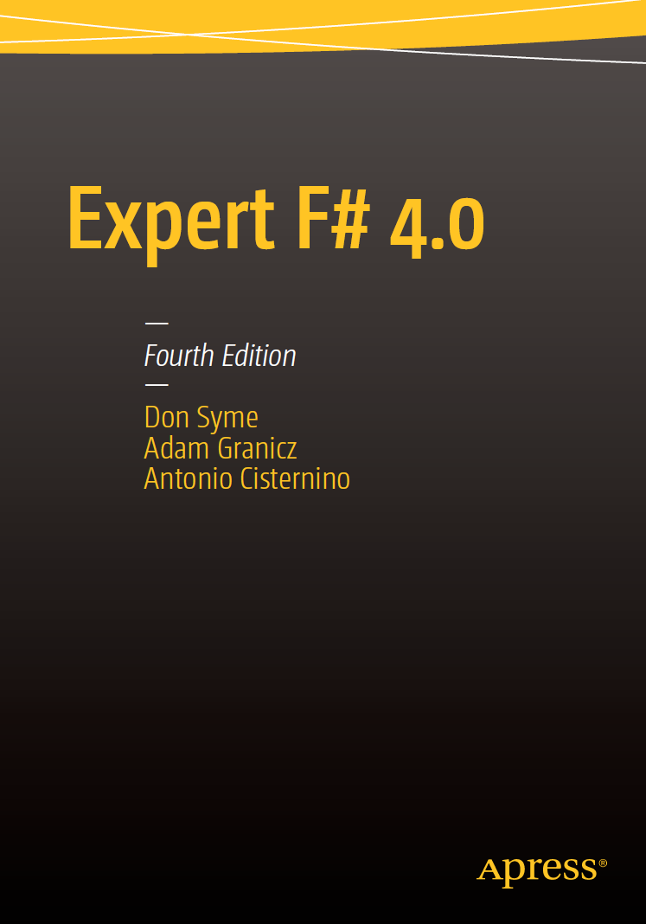
Notes:
But you’ve been dipping your toes in the water of functional programming.

Slide 4
Object-Oriented
Functional
Builder
Currying
Null Object
Pattern Matching
Template Method
Strategy
Partial Application
Adapter
Function Builder
State
Monads
Dependency
Injection
Map- Reduce
Visitor
Algebraic Data Types

Slide 5
Strategy
strategy
«interface»
IStrategy
Context
+DoSomething(): void
strategy.PerformBehavior()
+PerformBehavior(): void
ConcreteStrategyA
ConcreteStrategyB
ConcreteStrategyC
+PerformBehavior(): void
+PerformBehavior(): void
+PerformBehavior(): void

Slide 6
Strategy
Complex
+Re: double
+Im: double
+create(re: double, im: double): Complex

Slide 7
Strategy
strategy
«interface»
IStrategy
Context
+DoSomething(): void
strategy.performBehavior()
+PerformBehavior(): void
ConcreteStrategyA
ConcreteStrategyB
ConcreteStrategyC
+PerformBehavior(): void
+PerformBehavior(): void
+PerformBehavior(): void

Slide 8
Strategy
Complex
cmp
Complex
«interface»
IComparer
List
+Sort(cmp: IComparer): void
+Compare(x: Complex, y: Complex): int
cmp.Compare(x,y)
ComplexReImAscComparer
ComplexImReAscComparer
+Compare(x: Complex, y: Complex): int
+Compare(x: Complex, y: Complex): int

Slide 9
Strategy
C#
public class Complex
{
public readonly double Re;
public readonly double Im;
public Complex(double re, double im)
{
Re = re;
Im = im;
}
}

Slide 10
Strategy
C#
public class ComplexReImAscComparer : IComparer<Complex>
{
public int Compare(Complex x, Complex y)
{
var re = Math.Sign(x.Re - y.Re);
return re != 0 ? re : Math.Sign(x.Im - y.Im);
}
}

Slide 11
Strategy
C#
public class ComplexImReAscComparer : IComparer<Complex>
{
public int Compare(Complex x, Complex y)
{
var im = Math.Sign(x.Im - y.Im);
return im != 0 ? im : Math.Sign(x.Re - y.Re);
}
}

Slide 12
Strategy
C#
var xs = new List<Complex>()
{
new Complex( 4, 9),
new Complex(-3, 1),
new Complex( 1, -6),
new Complex(-3, -2),
new Complex( 7, 1),
};

Slide 13
Strategy
C#
Console.WriteLine("Ascending by Re, Im");
xs.Sort(new ComplexReImAscComparer());
foreach (var x in xs) Console.WriteLine(x);
Console.WriteLine();
Console.WriteLine("Ascending by Im, Re");
xs.Sort(new ComplexImReAscComparer());
foreach (var x in xs) Console.WriteLine(x);

Slide 14
Ascending by Re, Im
-3.0 - i2.0
-3.0 + i1.0
1.0 - i6.0
4.0 + i9.0
7.0 + i1.0
Ascending by Im, Re
1.0 - i6.0
-3.0 - i2.0
-3.0 + i1.0
7.0 + i1.0
4.0 + i9.0

Slide 15
Strategy
C#
public class ComplexReImAscComparer : IComparer<Complex>
{
public int Compare(Complex x, Complex y)
{
var re = Math.Sign(x.Re - y.Re);
return re != 0 ? re : Math.Sign(x.Im - y.Im);
}
}

Slide 16
IComparer<Complex>
Complex -> Complex -> int

Slide 17
Strategy
F#
type Complex = { Re : float; Im : float }
let xs = [ { Re = 4.0; Im = 9.0 }
{ Re = -3.0; Im = 1.0 }
{ Re = 1.0; Im = -6.0 }
{ Re = -3.0; Im = -2.0 }
{ Re = 7.0; Im = 1.0 } ]

Slide 18
Strategy
F#
let compareReImAsc x y =
let re = sign (x.Re - y.Re)
if re <> 0 then re else sign (x.Im - y.Im)
let compareImReAsc x y =
let im = sign (x.Im - y.Im)
if im <> 0 then im else sign (x.Re - y.Re)

Slide 19
Strategy
F#
printfn "Ascending by Re, Im"
xs
|> List.sortWith compareReImAsc |> List.iter (printfn "%O")
printfn ""
printfn "Ascending by Im, Re"
xs
|> List.sortWith compareImReAsc |> List.iter (printfn "%O")

Slide 20
Ascending by Re, Im
-3.0 - i2.0
-3.0 + i1.0
1.0 - i6.0
4.0 + i9.0
7.0 + i1.0
Ascending by Im, Re
1.0 - i6.0
-3.0 - i2.0
-3.0 + i1.0
7.0 + i1.0
4.0 + i9.0

Slide 21
Strategy
C#
F#
public class ComplexReImAscComparer : IComparer<Complex>
{
public int Compare(Complex x, Complex y)
{
var re = Math.Sign(x.Re - y.Re);
return re != 0 ? re : Math.Sign(x.Im - y.Im);
}
}
public class ComplexImReAscComparer : IComparer<Complex>
{
public int Compare(Complex x, Complex y)
{
var im = Math.Sign(x.Im - y.Im);
return im != 0 ? im : Math.Sign(x.Re - y.Re);
}
}
let compareReImAsc x y =
let re = sign (x.Re - y.Re)
if re <> 0 then re else sign (x.Im - y.Im)
let compareImReAsc x y =
let im = sign (x.Im - y.Im)
if im <> 0 then im else sign (x.Re - y.Re)

Slide 22
Strategy
string
p
string
«delegate»
Predicate
List
+FindAll(p: Predicate<string>): List<string>
+Test(obj: string): bool

Slide 23
Strategy
C#
public class StartsWith
{
public string Prefix { get; private set; }
public StartsWith(string prefix)
{
Prefix = prefix;
}
public bool Test(string sample)
{
return sample.StartsWith(Prefix);
}
}

Slide 24
Strategy
C#
var words = new List<string>()
{
"Lorem", "ipsum",
"dolor", "sit",
"amet", "consectetur",
"adipiscing", "elit",
};

Slide 25
Strategy
C#
var startsWithL = new StartsWith("L");
var lWords = words.FindAll(startsWithL.Test);
foreach (var word in lWords) Console.WriteLine(word);
var startsWithA = new StartsWith("a");
var aWords = words.FindAll(startsWithA.Test);
foreach (var word in aWords) Console.WriteLine(word);

Slide 26
Lorem
amet
adipiscing

Slide 27
Strategy
C#
public class StartsWith
{
public string Prefix { get; private set; }
public StartsWith(string prefix)
{
Prefix = prefix;
}
public bool Test(string sample)
{
return sample.StartsWith(Prefix);
}
}

Slide 28
Predicate<string>
string -> string -> bool

Slide 29
Strategy
F#
let startsWith prefix (str : string) =
str.StartsWith prefix
let words = [ "Lorem"; "ipsum"
"dolor"; "sit"
"amet"; "consectetur"
"adipiscing"; "elit" ]

Slide 30
Strategy
F#
let startsWithL = startsWith "L"
words
|> List.filter startsWithL
|> List.iter (printfn "%s")
let startsWithA = startsWith "a"
words
|> List.filter startsWithA
|> List.iter (printfn "%s")

Slide 31
Strategy
F#
words
|> List.filter (startsWith "L")
|> List.iter (printfn "%s")
words
|> List.filter (startsWith "a")
|> List.iter (printfn "%s")

Slide 32
Lorem
amet
adipiscing

Slide 33
Strategy
C#
F#
public class StartsWith
{
public string Prefix { get; private set; }
public StartsWith(string prefix)
{
Prefix = prefix;
}
public bool Test(string sample)
{
return sample.StartsWith(Prefix);
}
}
let startsWith prefix (str : string) =
str.StartsWith prefix

Slide 34
An Observation
C#
public class ComplexReImAscComparer : IComparer<Complex>
{
public int Compare(Complex x, Complex y)
{
var re = Math.Sign(x.Re - y.Re);
return re != 0 ? re : Math.Sign(x.Im - y.Im);
}
}
Just a function

Slide 35
An Observation
C#
public class StartsWith
{
public string Prefix { get; private set; }
public StartsWith(string prefix)
{
Prefix = prefix;
}
public bool Test(string sample)
{
return sample.StartsWith(Prefix);
}
}
A little state
Just a function

Slide 36


If you have a class with two methods, and one of them is the constructor, you have a function.
— @JackDied via @ReidNEvans
emphasis mine

Slide 37
Template Method
AbstractClass
…
PrimitiveOperation1()
…
PrimitiveOperation2()
…
+TemplateMethod()
+PrimitiveOperation1()
+PrimitiveOperation2()
ConcreteClassA
ConcreteClassB
+PrimitiveOperation1()
+PrimitiveOperation2()
+PrimitiveOperation1()
+PrimitiveOperation2()

Slide 38
Template Method
Product
+Name: string
+Category: string
+Price: decimal
+create(name: string, category: string, price: decimal): Product

Slide 39
Template Method
CalculateFederalTax(items)
CalculateStateTax(items)
CalculateLocalTax(items)
TaxCalculator
+CalculateTax(items: List<Product>): decimal
+CalculateFederalTax(items: List<Product>): decimal
+CalculateStateTax(items: List<Product>): decimal
+CalculateLocalTax(items: List<Product>): decimal
AgnorTaxCalculator
BristolTaxCalculator
+CalculateFederalTax(items: List<Product>)
+CalculateStateTax(items: List<Product>)
+CalculateLocalTax(items: List<Product>)
+CalculateFederalTax(items: List<Product>)
+CalculateStateTax(items: List<Product>)
+CalculateLocalTax(items: List<Product>)

Slide 40
Template Method
C#
public struct Product
{
public readonly string Name;
public readonly string Category;
public readonly decimal Price;
public Product(string name, string category, decimal price)
{
Name = name;
Category = category;
Price = price;
}
}

Slide 41
Template Method
C#
public abstract class TaxCalculator
{
public decimal CalculateTax(List<Product> items)
{
return CalculateFederalTax(items)
+ CalculateStateTax(items)
+ CalculateLocalTax(items);
}
public abstract decimal CalculateFederalTax(List<Product> items);
public abstract decimal CalculateStateTax(List<Product> items);
public abstract decimal CalculateLocalTax(List<Product> items);
}

Slide 42
Template Method
C#
public class AgnorTaxCalculator : TaxCalculator
{
public override decimal CalculateFederalTax(List<Product> items)
{
return 0;
}
public override decimal CalculateStateTax(List<Product> items)
{
const decimal rate = 0.06m;
var subtotal = 0.0m;
foreach (var item in items) subtotal += item.Price;
return subtotal * rate;
}
}

Slide 43
Template Method
C#
public class AgnorTaxCalculator : TaxCalculator
{
// ...
public override decimal CalculateLocalTax(List<Product> items)
{
const decimal rate = 0.03m;
var subtotal = 0.0m;
foreach (var item in items) subtotal += item.Price;
return subtotal * rate;
}
}

Slide 44
Template Method
C#
public class BristolTaxCalculator : TaxCalculator
{
public override decimal CalculateFederalTax(List<Product> items)
{
const decimal rate = 0.20m;
var subtotal = 0.0m;
foreach (var item in items) subtotal += item.Price;
return subtotal * rate;
}
public override decimal CalculateStateTax(List<Product> items)
{
return 0;
}
}

Slide 45
Template Method
C#
public class BristolTaxCalculator : TaxCalculator
{
// ...
public override decimal CalculateLocalTax(List<Product> items)
{
const decimal rate = 0.015m;
var subtotal = 0.0m;
foreach (var item in items)
{
if (item.Category == "Food" || item.Category == "Medical") continue;
subtotal += item.Price;
}
return subtotal * rate;
}
}

Slide 46
Template Method
C#
var items = new List<Product>()
{
new Product("Fan", "Appliance", 19.99m),
new Product("Nexium", "Medical", 69.99m),
new Product("Chicken Thighs", "Food", 7.99m),
new Product("Corn Flakes", "Food", 4.99m),
new Product("Bed Sheets", "Linen", 129.99m),
new Product("Adjustable Wrench", "Hardware", 6.99m),
};

Slide 47
Template Method
C#
var subtotal = 0.0m;
foreach (var item in items) subtotal += item.Price;
var agnorTax = new AgnorTaxCalculator().CalculateTax(items);
var bristolTax = new BristolTaxCalculator()
.CalculateTax(items);
Console.WriteLine("Tax on ${0} of goods in Agnor: ${1:0.00}",
subtotal, agnorTax);
Console.WriteLine("Tax on ${0} of goods in Bristol: ${1:0.00}",
subtotal, bristolTax);

Slide 48
Tax on $239.94 of goods in Agnor: $21.59
Tax on $239.94 of goods in Bristol: $50.34

Slide 49
Template Method
C#
public abstract class TaxCalculator
{
public decimal CalculateTax(List<Product> items)
{
return CalculateFederalTax(items)
+ CalculateStateTax(items)
+ CalculateLocalTax(items);
}
public abstract decimal CalculateFederalTax(List<Product> items);
public abstract decimal CalculateStateTax(List<Product> items);
public abstract decimal CalculateLocalTax(List<Product> items);
}
public class AgnorTaxCalculator : TaxCalculator
{
public override decimal CalculateFederalTax(List<Product> items)
{
return 0;
}
public override decimal CalculateStateTax(List<Product> items)
{
const decimal rate = 0.06m;
var subtotal = 0.0m;
foreach (var item in items) subtotal += item.Price;
return subtotal * rate;
}
public override decimal CalculateLocalTax(List<Product> items)
{
const decimal rate = 0.03m;
var subtotal = 0.0m;
foreach (var item in items) subtotal += item.Price;
return subtotal * rate;
}
}

Slide 50
TaxCalculator
Product list -> decimal

Slide 51
TaxCalculator
(Product list -> decimal) -> (Product list -> decimal) -> (Product list -> decimal) -> Product list -> decimal
Product list -> decimal

Slide 52
Template Method
F#
type Product =
{ Name : string
Category : string
Price : decimal }
let calculateTax calcFedTax calcStateTax calcLocalTax items =
calcFedTax items +
calcStateTax items +
calcLocalTax items

Slide 53
Template Method
F#
let getPrice item = item.Price
let taxAt rate subtotal = rate * subtotal
let buildTaxCalculator exemptCategories rate =
let isTaxable item = exemptCategories
|> List.contains item.Category
|> not
Seq.filter isTaxable
>> Seq.map getPrice
>> Seq.sum
>> taxAt rate

Slide 54
Template Method
F#
let calculateTaxInAgnor =
let calcFedTax _ = 0.0m
let calcStateTax = buildTaxCalculator [] 0.06m
let calcLocalTax = buildTaxCalculator [] 0.03m
calculateTax calcFedTax calcStateTax calcLocalTax

Slide 55
Template Method
F#
let calculateTaxInBristol =
let calcFedTax = buildTaxCalculator [] 0.20m
let calcStateTax _ = 0.0m
let calcLocalTax =
buildTaxCalculator ["Food"; "Medical"] 0.015m
calculateTax calcFedTax calcStateTax calcLocalTax

Slide 56
Template Method
F#
let items = [
{ Name="Fan"; Category="Appliance"; Price= 19.99m }
{ Name="Nexium"; Category="Medical"; Price= 69.99m }
{ Name="Chicken Thighs"; Category="Food"; Price= 7.99m }
{ Name="Corn Flakes"; Category="Food"; Price= 4.99m }
{ Name="Bed Sheets"; Category="Linen"; Price=129.99m }
{ Name="Adjustable Wrench"; Category="Hardware"; Price= 6.99m }
]

Slide 57
Template Method
F#
let subtotal = items
|> Seq.map getPrice
|> Seq.sum
let agnorTax = calculateTaxInAgnor items
let bristolTax = calculateTaxInBristol items
printfn "Tax on $%.2f of goods in Agnor: $%.2f"
subtotal agnorTax
printfn "Tax on $%.2f of goods in Bristol: $%.2f"
subtotal bristolTax

Slide 58
Tax on $239.94 of goods in Agnor: $21.59
Tax on $239.94 of goods in Bristol: $50.34

Slide 59
Template Method
C#
F#
public abstract class TaxCalculator
{
public decimal CalculateTax(List<Product> items)
{
return CalculateFederalTax(items)
+ CalculateStateTax(items)
+ CalculateLocalTax(items);
}
public abstract decimal CalculateFederalTax(List<Product> items);
public abstract decimal CalculateStateTax(List<Product> items);
public abstract decimal CalculateLocalTax(List<Product> items);
}
public class AgnorTaxCalculator : TaxCalculator
{
public override decimal CalculateFederalTax(List<Product> items)
{
return 0;
}
public override decimal CalculateStateTax(List<Product> items)
{
const decimal rate = 0.06m;
var subtotal = 0.0m;
foreach (var item in items) subtotal += item.Price;
return subtotal * rate;
}
public override decimal CalculateLocalTax(List<Product> items)
{
const decimal rate = 0.03m;
var subtotal = 0.0m;
foreach (var item in items) subtotal += item.Price;
return subtotal * rate;
}
}
public class BristolTaxCalculator : TaxCalculator
{
public override decimal CalculateFederalTax(List<Product> items)
{
const decimal rate = 0.20m;
var subtotal = 0.0m;
foreach (var item in items) subtotal += item.Price;
return subtotal * rate;
}
public override decimal CalculateStateTax(List<Product> items)
{
return 0;
}
public override decimal CalculateLocalTax(List<Product> items)
{
const decimal rate = 0.015m;
var subtotal = 0.0m;
foreach (var item in items)
{
if (item.Category == "Food" || item.Category == "Medical") continue;
subtotal += item.Price;
}
return subtotal * rate;
}
}
let calculateTax calcFedTax calcStateTax calcLocalTax items =
calcFedTax items +
calcStateTax items +
calcLocalTax items
let getPrice item = item.Price
let taxAt rate subtotal = rate * subtotal
let buildTaxCalculator exemptCategories rate =
let isTaxable item = exemptCategories
|> List.contains item.Category
|> not
Seq.filter isTaxable
>> Seq.map getPrice
>> Seq.sum
>> taxAt rate
let calculateTaxInAgnor =
let calcFedTax _ = 0.0m
let calcStateTax = buildTaxCalculator [] 0.06m
let calcLocalTax = buildTaxCalculator [] 0.03m
calculateTax calcFedTax calcStateTax calcLocalTax
let calculateTaxInBristol =
let calcFedTax = buildTaxCalculator [] 0.20m
let calcStateTax _ = 0.0m
let calcLocalTax =
buildTaxCalculator ["Food"; "Medical"] 0.015m
calculateTax calcFedTax calcStateTax calcLocalTax

Slide 60
Dependency Injection
«interface»
IServiceA
Resource
+create(:IServiceA, :IServiceB)
+Execute()
+Operation()
«interface»
IServiceB
+Operation()

Slide 61
Dependency Injection
loggingService
«interface»
ILoggingService
PersonRepository
+create(:ILoggingService, :IDataService)
+GetPerson(id: long): Person
+Log(message: string): void
dataService
«interface»
IDataService
+LoadPerson(id: long): Person

Slide 62
Dependency Injection
C#
public class PersonRepository
{
private readonly ILoggingService loggingSvc;
private readonly IDataService dataSvc;
public PersonRepository(ILoggingService loggingSvc,
IDataService dataSvc)
{
this.loggingSvc = loggingSvc;
this.dataSvc = dataSvc;
}
}

Slide 63
Dependency Injection
C#
public class PersonRepository
{
// ...
public Person GetPerson(long id)
{
var person = dataSvc.LoadPerson(id);
loggingSvc.Log($"Loaded Person: {person?.ToString() ?? "(null)"}");
return person;
}
}

Slide 64
Dependency Injection
C#
public interface ILoggingService
{
void Log(string message);
}
public class ConsoleLogger : ILoggingService
{
public void Log(string message)
{
Console.WriteLine(message);
}
}

Slide 65
Dependency Injection
C#
public interface IDataService
{
Person LoadPerson(long id);
}
public class SimpleDataService : IDataService
{
private readonly List<Person> persons = new List<Person>() { /* ... */ };
public Person LoadPerson(long id)
{
return id < persons.Count ? persons[(int)id] : null;
}
}

Slide 66
Dependency Injection
C#
var loggerSvc = new ConsoleLogger();
var dataSvc = new SimpleDataService();
var repo = new PersonRepository(loggerSvc, dataSvc);
var person = repo.GetPerson(5);
Console.WriteLine($"Fetched from repo: {person}");

Slide 67
Loaded Person: Percival Plum
Fetched from repo: Percival Plum

Slide 68
Dependency Injection
C#
public class PersonRepository
{
private readonly ILoggingService loggingSvc;
private readonly IDataService dataSvc;
public PersonRepository(ILoggingService loggingSvc, IDataService dataSvc)
{
this.loggingSvc = loggingSvc;
this.dataSvc = dataSvc;
}
public Person GetPerson(long id)
{
var person = dataSvc.LoadPerson(id);
loggingSvc.Log($"Loaded Person: {person?.ToString() ?? "(null)"}");
return person;
}
}
public class ConsoleLogger : ILoggingService
{
public void Log(string message)
{
Console.WriteLine(message);
}
}
public class SimpleDataService : IDataService
{
private readonly List<Person> persons = new List<Person>() { /* ... */ };
public Person LoadPerson(long id)
{
return id < persons.Count ? persons[(int)id] : null;
}
}

Slide 69
PersonRepository
(string -> unit) -> (long -> Person option) -> long -> Person option
long -> Person option

Slide 70
Dependency Injection
F#
let repository log loadPerson id =
let person = loadPerson id
log (sprintf "Loaded Person: %O" person)
person
let logger = printfn "%s"
let dataSvc id =
[ (* ... *) ]
|> List.tryItem id

Slide 71
Dependency Injection
F#
let getPerson = repository logger dataSvc
let person = getPerson 5
printfn "Fetched from repo: %O" person

Slide 72
Loaded Person: Some(Percival Plum)
Fetched from repo: Some(Percival Plum)

Slide 73
Dependency Injection
C#
F#
public interface ILoggingService
{
void Log(string message);
}
public interface IDataService
{
Person LoadPerson(long id);
}
public class PersonRepository
{
private readonly ILoggingService loggingSvc;
private readonly IDataService dataSvc;
public PersonRepository(ILoggingService loggingSvc, IDataService dataSvc)
{
this.loggingSvc = loggingSvc;
this.dataSvc = dataSvc;
}
public Person GetPerson(long id)
{
var person = dataSvc.LoadPerson(id);
loggingSvc.Log($"Loaded Person: {person?.ToString() ?? "(null)"}");
return person;
}
}
public class ConsoleLogger : ILoggingService
{
public void Log(string message)
{
Console.WriteLine(message);
}
}
public class SimpleDataService : IDataService
{
private readonly List<Person> persons = new List<Person>() { /* ... */ };
public Person LoadPerson(long id)
{
return id < persons.Count ? persons[(int)id] : null;
}
}
let repository log loadPerson id =
let person = loadPerson id
log (sprintf "Loaded Person: %O" person)
person
let logger = printfn "%s“
let dataSvc id =
[ (* ... *) ]
|> List.tryItem id

Slide 74
Look to the function

Slide 75
Look to the function
Pass around as a first-class value
Load with state/functionality via partial application
No class baggage: Just a function signature
Easier testing: Match a function signature, not a class/interface
Notes:
First-class value: A contributing factor in many OO design patterns is that you cannot (easily) pass around a function. You have to attach it to a class to pass it around and use it.
Partial application: Another reason OO languages require you to make a function an appendage of a class is so that you can pass around state with that function. You set that state in the constructor and then later invocations of the function can use that state in its calculations. We can partially apply F#’s automatically curried functions.

Slide 76


'a -> 'b

Slide 77
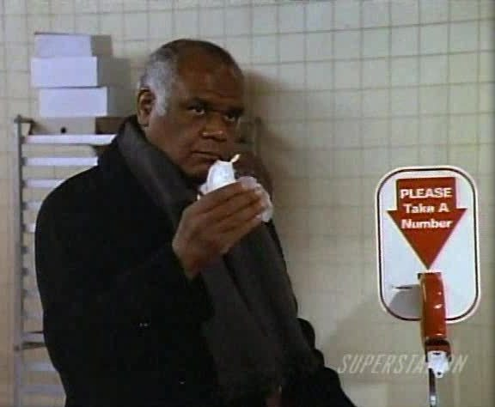

'a -> 'b

Slide 78
'a -> 'b
'a -> 'b

Slide 79
State
«interface»
IState
Context
+Event1()
+Event2()
+Event3()
+Event1()
+Event2()
+Event3()
state
State1
State2
State3
+Event1()
+Event2()
+Event3()
+Event1()
+Event2()
+Event3()
+Event1()
+Event2()
+Event3()

Slide 80
State
inserts quarter
No Quarter
Has Quarter
Out of Gumballs
ejects quarter
[gumballs > 0]
turn crank / dispense gumball
[gumballs = 0]

Slide 81
State
«interface»
IState
GumballMachine
state
+Gumballs: int
+Gumballs: int
+InsertQuarter()
+EjectQuarter()
+Dispense()
+InsertQuarter(): IState
+EjectQuarter(): IState
+Dispense(): IState
NoQuarterState
HasQuarterState
SoldOutState
+Gumballs: int
+Gumballs: int
+Gumballs: int
+InsertQuarter(): IState
+EjectQuarter(): IState
+Dispense(): IState
+InsertQuarter(): IState
+EjectQuarter(): IState
+Dispense(): IState
+InsertQuarter(): IState
+EjectQuarter(): IState
+Dispense(): IState

Slide 82
State
C#
public interface IState
{
int Gumballs { get; }
IState InsertQuarter();
IState EjectQuarter();
IState Dispense();
}

Slide 83
State
C#
public class GumballMachine
{
private IState state;
public GumballMachine(int gumballs)
{
this.state = new NoQuarterState(gumballs);
}
public int Gumballs { get { return state.Gumballs; } }
}

Slide 84
State
C#
public class GumballMachine
{
// ...
public void InsertQuarter() { state = state.InsertQuarter(); }
public void EjectQuarter() { state = state.EjectQuarter(); }
public void Dispense() { state = state.Dispense(); }
public override string ToString()
{
return $"Gumball Machine with {Gumballs} gumballs";
}
}

Slide 85
State
C#
public class NoQuarterState : IState
{
public NoQuarterState(int gumballs) { Gumballs = gumballs; }
public int Gumballs { get; private set; }
public IState InsertQuarter()
{
return new HasQuarterState(Gumballs);
}
public IState EjectQuarter() { return this; }
public IState Dispense() { return this; }
}

Slide 86
State
C#
public class HasQuarterState : IState
{
public HasQuarterState(int gumballs) { Gumballs = gumballs; }
public int Gumballs { get; private set; }
public IState InsertQuarter() { return this; }
public IState EjectQuarter()
{
return new NoQuarterState(Gumballs);
}
}

Slide 87
State
C#
public class HasQuarterState : IState
{
// ...
public IState Dispense()
{
return Gumballs == 1
? new SoldOutState() as IState
: new NoQuarterState(Gumballs - 1);
}
}

Slide 88
State
C#
public class SoldOutState : IState
{
public int Gumballs { get { return 0; } }
public IState InsertQuarter() { return this; }
public IState EjectQuarter() { return this; }
public IState Dispense() { return this; }
}

Slide 89
State
C#
var machine = new GumballMachine(3);
machine.InsertQuarter();
Console.WriteLine($"After Insert Quarter: {machine}");
machine.Dispense();
Console.WriteLine($"After Dispense: {machine}");
machine.InsertQuarter();
Console.WriteLine($"After Insert Quarter: {machine}");
machine.EjectQuarter();
Console.WriteLine($"After Eject Quarter: {machine}");
// ...

Slide 90
After Insert Quarter: Gumball Machine with 3 gumballs
After Dispense: Gumball Machine with 2 gumballs
After Insert Quarter: Gumball Machine with 2 gumballs
After Eject Quarter: Gumball Machine with 2 gumballs
After Dispense: Gumball Machine with 2 gumballs
After Insert Quarter: Gumball Machine with 2 gumballs
After Dispense: Gumball Machine with 1 gumballs
After Insert Quarter: Gumball Machine with 1 gumballs
After Dispense: Gumball Machine with 0 gumballs
After Insert Quarter: Gumball Machine with 0 gumballs
After Dispense: Gumball Machine with 0 gumballs

Slide 91
State
F#
type State =
| NoQuarter of int
| HasQuarter of int
| SoldOut
type Event =
| InsertQuarter
| EjectQuarter
| Dispense

Slide 92
State
F#
let execute event state =
match event, state with
| InsertQuarter, NoQuarter n -> HasQuarter n
| EjectQuarter, HasQuarter n -> NoQuarter n
| Dispense, HasQuarter gumballs ->
match gumballs with
| 1 -> SoldOut
| _ -> NoQuarter (gumballs - 1)
| _ -> state

Slide 93
State
F#
let events = [ InsertQuarter
Dispense
InsertQuarter
EjectQuarter
Dispense
InsertQuarter
Dispense
InsertQuarter
Dispense
InsertQuarter
Dispense ]

Slide 94
State
F#
let init = EjectQuarter, NoQuarter 3
events
|> Seq.scan (fun current event ->
let _, state = current
event, execute event state)
init
|> Seq.skip 1
|> Seq.iter (fun (evt, state) ->
printfn "%A -> %A" evt state)

Slide 95
InsertQuarter -> HasQuarter 3
Dispense -> NoQuarter 2
InsertQuarter -> HasQuarter 2
EjectQuarter -> NoQuarter 2
Dispense -> NoQuarter 2
InsertQuarter -> HasQuarter 2
Dispense -> NoQuarter 1
InsertQuarter -> HasQuarter 1
Dispense -> SoldOut
InsertQuarter -> SoldOut
Dispense -> SoldOut

Slide 96
State
C#
F#
public interface Istate
{
int Gumballs { get; }
IState InsertQuarter();
IState EjectQuarter();
IState Dispense();
}
public class NoQuarterState : Istate
{
public NoQuarterState(int gumballs) { Gumballs = gumballs; }
public int Gumballs { get; private set; }
public IState InsertQuarter() { return new HasQuarterState(Gumballs); }
public IState EjectQuarter() { return this; }
public IState Dispense() { return this; }
}
public class HasQuarterState : Istate
{
public HasQuarterState(int gumballs) { Gumballs = gumballs; }
public int Gumballs { get; private set; }
public IState InsertQuarter() { return this; }
public IState EjectQuarter() { return new NoQuarterState(Gumballs); }
public IState Dispense()
{
return Gumballs == 1 ? new SoldOutState() as IState : new NoQuarterState(Gumballs - 1);
}
}
public class SoldOutState : Istate
{
public int Gumballs { get { return 0; } }
public IState InsertQuarter() { return this; }
public IState EjectQuarter() { return this; }
public IState Dispense() { return this; }
}
public class GumballMachine
{
private IState state;
public GumballMachine(int gumballs) { this.state = new NoQuarterState(gumballs); }
public int Gumballs { get { return state.Gumballs; } }
public void InsertQuarter() { state = state.InsertQuarter(); }
public void EjectQuarter() { state = state.EjectQuarter(); }
public void Dispense() { state = state.Dispense(); }
public override string ToString() { return $"Gumball Machine with {Gumballs} gumballs"; }
}
type State =
| NoQuarter of int
| HasQuarter of int
| SoldOut
type Event =
| InsertQuarter
| EjectQuarter
| Dispense
let execute event state =
match event, state with
| InsertQuarter, NoQuarter n -> HasQuarter n
| EjectQuarter, HasQuarter n -> NoQuarter n
| Dispense, HasQuarter gumballs ->
match gumballs with
| 1 -> SoldOut
| _ -> NoQuarter (gumballs - 1)
| _ -> state

Slide 97
State
Discriminated unions:
Poor man’s inheritance/polymorphism
Represent events as values instead of method calls
Pattern matching:
Handle catch-all/default cases all in one place
Compiler fails to compile if all cases are not covered

Slide 98
Summary
Look to the function
Use partial application to load functions with state
Use discriminated unions for polymorphic values and represent events as values
Use pattern matching to employ the compiler as guarantee that all cases are covered

Slide 99
Other Examples
Visitor
Composite
Adapter
Null Object

Slide 100
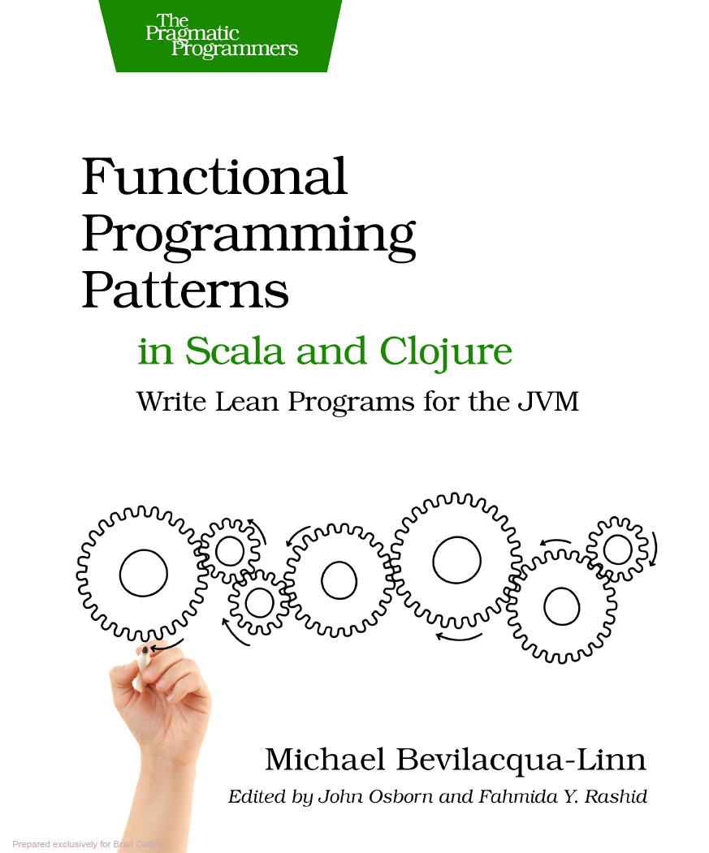
Additional examples
Gentle introduction to Scala & Clojure

Slide 101

Can’t do F# at work?

Slide 102

Notes:
Uncle Owen: “You can waste time with your monads after your chores are done.”

Slide 103
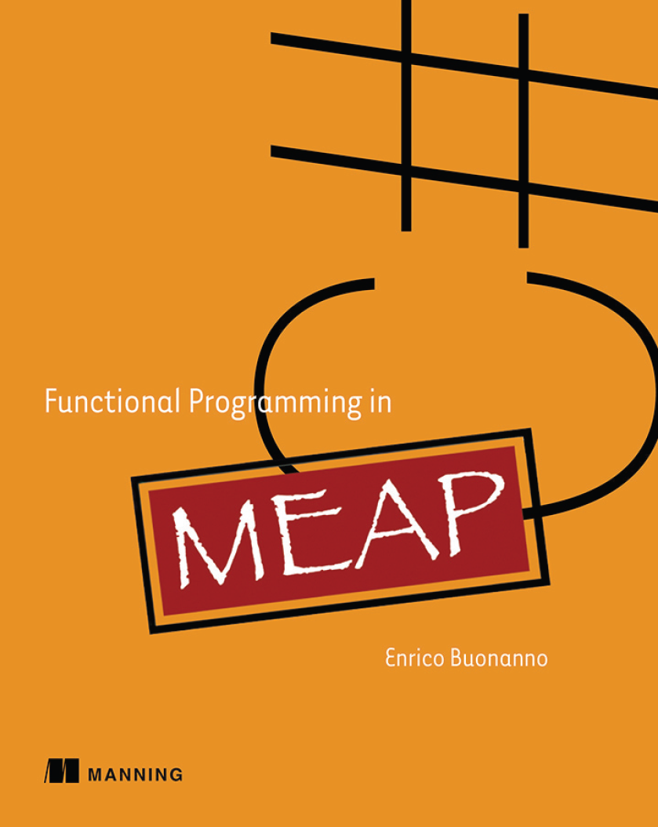
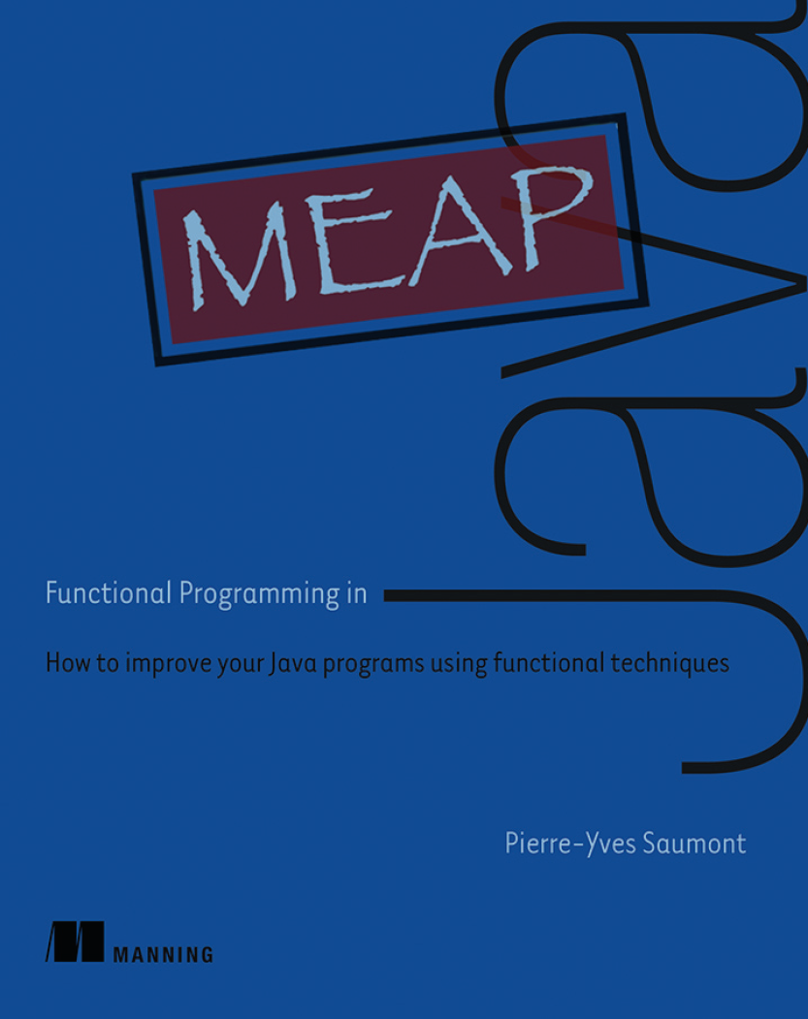
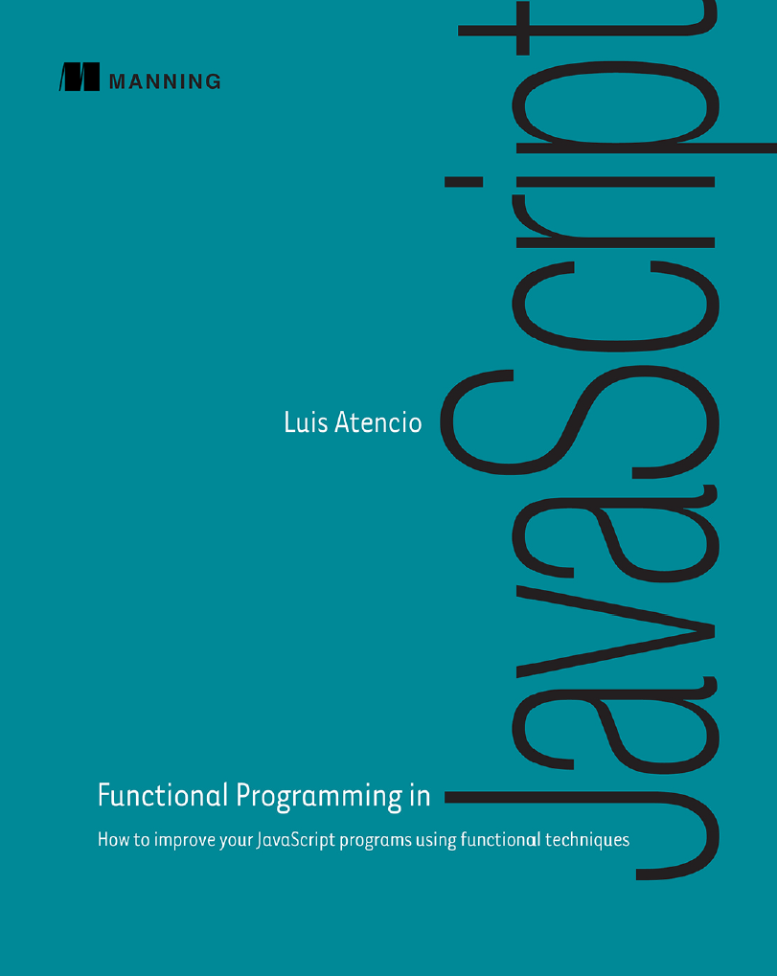

Slide 104
int(*func)(int, int)
int (Class::*method)(int, int)

Slide 105


Slide 106
int(*func)(int, int)
int (Class::*method)(int, int)
Func<int, int, int> func
function func(x,y) { /*...*/ }

Slide 107










DevSpace would like to thank our sponsors!

Slide 108
Image Credits
Joy Gas service station elevation drawings, 910 Lake Shore Road Blvd W., Toronto, Canada. https://commons.wikimedia.org/wiki/File:Joy_Oil_gas_station_blueprints.jpg
Top Ten Seinfeld Locations in NYC. http://guestofaguest.com/wp-content/uploads/2010/07/g57zu7unymda43ucsrltelcto1_r1_500.jpg
Your Options, According to Yoda. http://i.imgur.com/sxtu4l.png
Amelia's Sad Face | Donnie Ray Jones | Flickr https://www.flickr.com/photos/donnieray/9436653177
Club Jade • “But I was going into Tosche Station to pick up... http://clubjade.tumblr.com/post/74278187340/but-i-was-going-into-tosche-station-to-pick-up
Monty Python and the Holy Grail images Ack! wallpaper and background photos http://images.fanpop.com/images/image_uploads/Ack--monty-python-and-the-holy-grail-591667_800_441.jpg

